Slide 1
Predicting Exxon Prices Using Sentiment Analysis

Slide 2
Objective
Determine relationship of the energy market with sentiment on the energy industry based on news articles from the New York Times.

Slide 3
Interest in Topic
Curious about global events that affect energy industry
Build investment strategy based on sentiment
Opportunity to explore Machine Learning tools
Practice using data extraction from an API

Slide 4
Hypothesis
Using Sentiment Analysis on historical data, we can create a trade model that could have predicted oil prices similar to actual crude oil prices

Slide 5
Data Collection
New York Times Articles API
Crude oil historical prices
Exxon historical stock prices
All data extracted was from 2010 to 2020

Slide 6
Data Extraction
Article filtering
Keywords: oil, petroleum, energy, natural gas
Obtained article abstracts, URLs, snippets, and IDs
Saved article information in JSON format
Used Beautiful Soup to web scrape through URLs

Slide 7
VADER Sentiment Analysis
NLTK – Natural Language Tookit
Loop through JSON data of article snippets
VADER opinion mining
Range of compound score from -1 to 1
Positive: >= 0.5
Neutral: >= -0.5 and < 0.5
Negative: <= -0.5

Slide 8

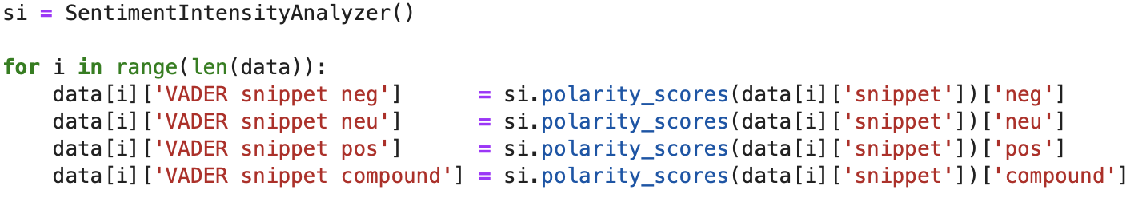
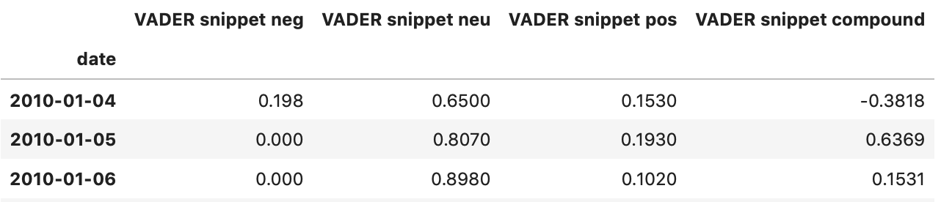
VADER Code

Slide 9

Random Forest Regression with Crude Oil Prices
Combines the predictions of training data to produce decision trees
Averages the predictions from all trees
https://towardsdatascience.com/random-forest-and-its-implementation-71824ced454f

Slide 10
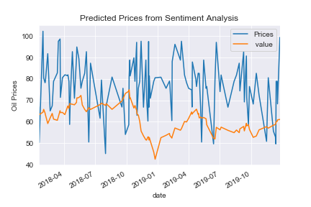
Predicted Oil Prices vs Actual

Slide 11
Random Tree Regression with Exxon Stock Data

Slide 12
Spacy Modeling
We used spaCy to capture all the words in the abstracts of all the articles we used in our Vader analysis. We then tokenized the data to break each sentence apart into works and we ended up with a list of words. Then we used the lemmatization process to break each token into its root. Now that our Corpas was created we then looped over it to count the most frequent words within the abstract. From there we searched for 7 key words: United and China, Exxon and Shell, Gas and Energy, and lastly President (removed all articles that were not related to the US president.)

